Slide 1
Market Basket Analyais using Apriori Algorithm
KLS Gogte Institute of Technology Department of MCA
Research Paper Presentation on
Prepared by :-
Bhupal Patil 2GI20MCA66
Laxmi Khot 2GI20MCA70

Slide 2
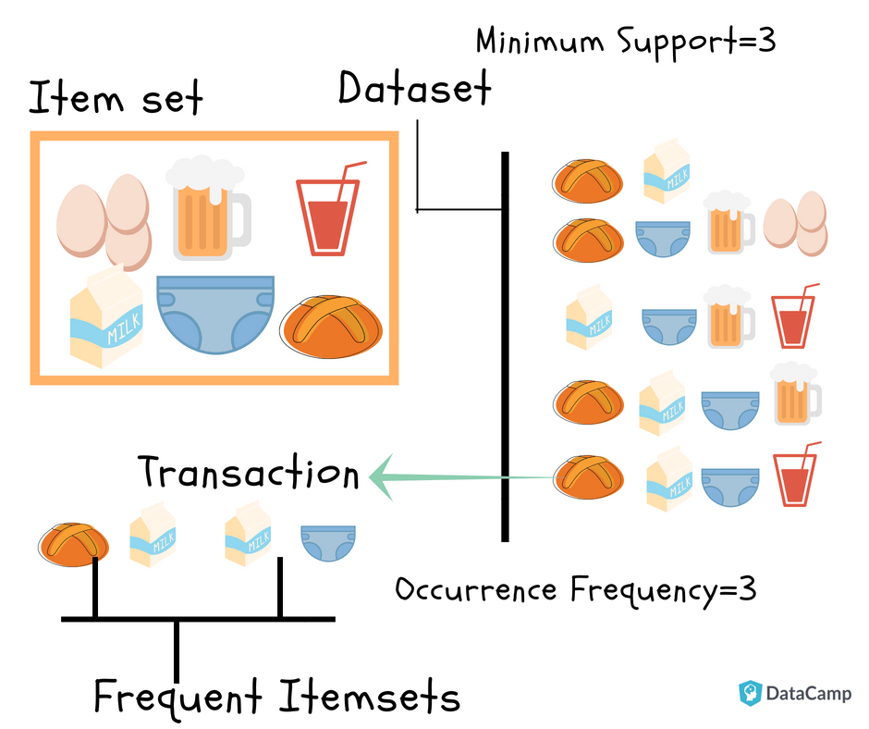
1. Introduction
Market basket analysis is a data mining technique used by retailers to increase their sales by better understanding customer purchasing patterns.
It works on the principle of Apriori algorithm

Slide 3
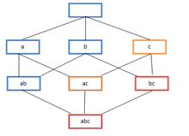
Apriori algorithm
It used to calculate the association rules between items.
The association rule describes how two or more objects are related to one another.
Used in mining frequent item-sets and relevant association rules.
Collect the External Dataset
Data Preprocessing
Apply Support and Confidence
Generate Frequent Item sets
Apply Apriori Algorithm
Filter records based on minSupport & minConfidence
Final Item-set

Slide 4
Terms used in Apriori algorithm
1. Support
2. Confidence
3. Lift
4. Leverage
5. Conviction

Slide 5
Thank You

